Slide 1
K-means Clustering
Marlabs

Slide 2
Clustering VS. Classification
In general, in classification you have a set of predefined classes and want to know which class a new object belongs to.
Clustering tries to group a set of objects and find whether there is some relationship between the objects.
In the context of machine learning, classification is supervised learning and clustering is unsupervised learning.

Slide 3
K-means Clustering
K-means clustering is on of the most popular clustering algorithms.
Clustering is a technique that allows us to find groups of similar objects that are more related to each other than to objects in other groups.
E.g.: the grouping of documents, music and movies by different topics, or finding customers that share similar interests based on common purchase behaviors.

Slide 4
K-Means Steps
Pick k centroids from the sample points as initial cluster centers.
Assign each sample to the nearest centroid.
Move the centroids to the center of the samples that were assigned to it.
Repeat steps 2 and 3 until the cluster assignments do not change or a user-defined tolerance or maximum number of iterations is reached.

Slide 5
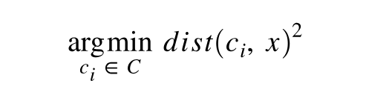
K-Means Steps
Steps: 1,2 -> Data assignment step.
Each data point is assigned to its nearest centroid, based on the squared Euclidean distance.
dist(): is the standard (L₂) Euclidean distance.
c_{i}: the collection of centroids in set C.
x: data points.

Slide 6
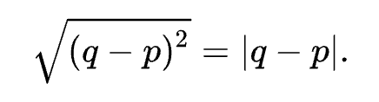
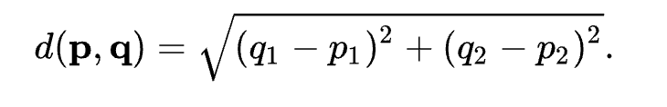
Euclidean Distance
One dimension:
If p and q are two points on the real line, then the distance between them is given by:
Two dimensions:
In the Euclidean Plane, if p = (p1, p2) and q = (q1, q2) then the distance is given by:
n dimensions:

Slide 7
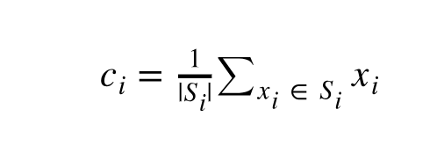
K-Means Steps
Step: 3 -> Centroid update step
The centroids are recomputed. This is done by taking the mean of all data points assigned to that centroid's cluster.
S_{i}: the set of data point assignments for each i^{th} cluster centroid.

Slide 8
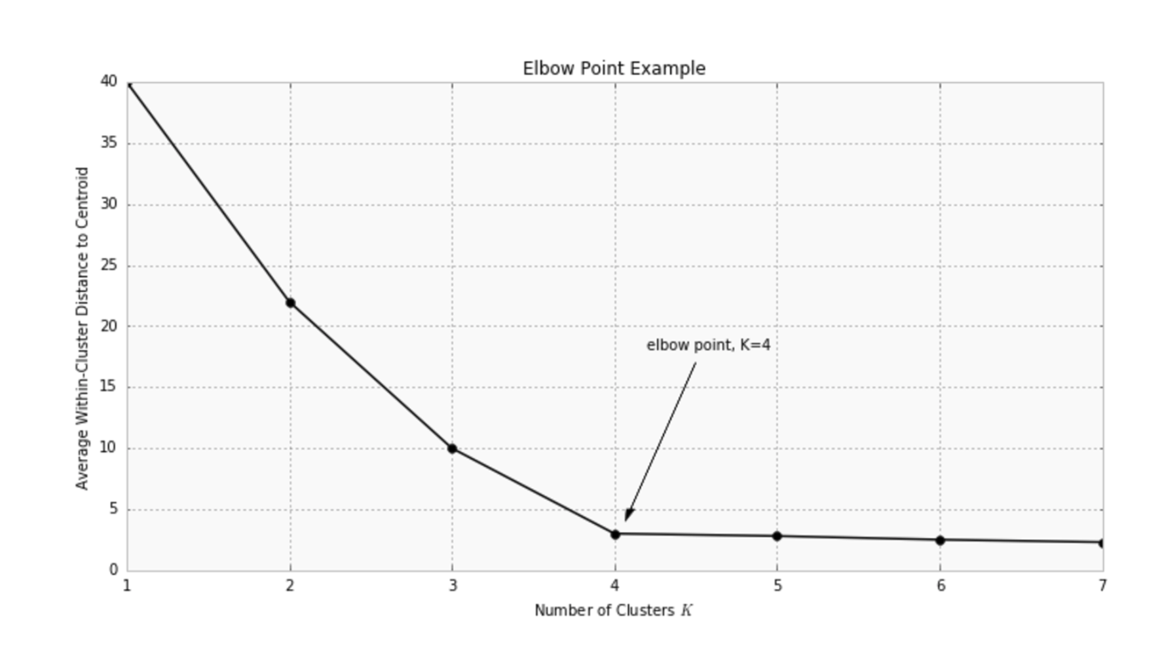
Choosing K
The K is pre-chosen for the algorithm described above.
Mean distance to the centroid as a function of K is plotted as follows, and the “elbow point”, where the rate of decrease sharply shifts, can be used to roughly determine K (Elbow Method).

